Slide 1
Boyer Moore’s Algorithm {
[String Matching]
< Presented by: Yahia Mohamed Anas >
}
Programming Language

Slide 2
Table Of ‘Contents’ {
01
02
03
Introduction
< Why use this algorithm & what are the techniques used >
Visual Representation
< Demonstration on how this algorithm works >
Code Implementation
< Implemented code using python >
04
Code Analysis
}
< Implemented code analysis >
Programming Language

Slide 3
01 {
[Introduction]
< Why use this algorithm & What is Boyer Moore’s algorithm >
}
Programming Language

Slide 4
Why use Boyer Moore’s Algorithm < /1 > {
< Brute force keep considering too many comparisons, So the time complexity increase O(mn).That’s why Boyer-Moore Algorithm. It works the fastest when the alphabet is moderately sized and the pattern is relatively long. >
}
What is Boyer’s Moore < /2 > {
< The algorithm scans the characters of the pattern from right to left i.e beginning with the rightmost character.
If the text symbol that is compared with the rightmost pattern symbol does not occur in the pattern at all, then the pattern can be shifted by m positions behind this text symbol. >
}

Slide 5
02 {
[Visual Representation]
< Demonstration on how this algorithm works >
}
Programming Language

Slide 6
Steps to use BM’s algorithm {
# We should know it uses preprocessing “Input enhancement”
Step 01
Construct our Bad-Symbol Shift Table using the Formula: Distance from c’s right most occurrence in pattern among its first m-1 characters to its right end
Step 02
Construct our Bad-Suffix Shift Table using the Formula : According to its 3 case checks
Step 03
Iterate string checking using MAX value from both Shift Tables untill successfully find a match or reach the end of the text
}

Slide 7
Construct BS-ST { Text: DONTEATSALTDANCESALSA Pattern: SALSA
Pattern: S A L S A Length = 5
Index : 0 1 2 3 4
}

Slide 8
Construct BS-ST {
Pattern: S A L S A Length = 5
Index : 0 1 2 3 4
Letter | S | A | L | *
D1 |  | 3
}

Slide 9
Construct BS-ST {
Pattern: S A L S A Length = 5
Index : 0 1 2 3 4
Letter | S | A | L | *
D1 | 1 | 3
}

Slide 10
Construct BS-ST {
Pattern: S A L S A Length = 5
Index : 0 1 2 3 4
Letter | S | A | L | *
D1 | 1 | 3 | 2
}

Slide 11
Construct BS-ST {
Pattern: S A L S A Length = 5
Index : 0 1 2 3 4
Letter | S | A | L | *
D1 | 1 | 3 | 2 | 5
Formula: Any letter is represented by ‘*’
With a value of ‘5’ #Length of pattern
}

Slide 12
Construct GS-ST { Text: DONTEATSALTDANCESALSA Pattern: SALSA
# Case 1: the distance between matched suffix of size k and its rightmost occurrence in the pattern that is not preceded by the same character as the suffix
Pattern: D O N T E A T S A L T D A N C E S A L S A
Index : 0 1 2 3 4 5 6 7 8 9 10 11 12 13 14 15 16 17 18 19 20
K | 1 | 2 | 3 | 4
Pattern | SALSA
D2
}
Case 1 failed

Slide 13
Construct GS-ST { Text: DONTEATSALTDANCESALSA Pattern: SALSA
# Case 2: match the longest part of the k-character suffix with corresponding prefix
Pattern: D O N T E A T S A L T D A N C E S A L S A
Index : 0 1 2 3 4 5 6 7 8 9 10 11 12 13 14 15 16 17 18 19 20
K | 1 | 2 | 3 | 4
Pattern | SALSA
D2
}
Case 2 failed

Slide 14
Construct GS-ST { Text: DONTEATSALTDANCESALSA Pattern: SALSA
# Case 3: if Case #1 & #2 failed then, D2 (k) = len(pattern)
Pattern: D O N T E A T S A L T D A N C E S A L S A
Index : 0 1 2 3 4 5 6 7 8 9 10 11 12 13 14 15 16 17 18 19 20
K | 1 | 2 | 3 | 4
Pattern | SALSA
D2 | 5
}

Slide 15
Construct GS-ST { Text: DONTEATSALTDANCESALSA Pattern: SALSA
# Case 1: The distance between matched suffix of size k and its rightmost occurrence in the pattern that is not preceded by the same character as the suffix
Pattern: D O N T E A T S A L T D A N C E S A L S A
Index : 0 1 2 3 4 5 6 7 8 9 10 11 12 13 14 15 16 17 18 19 20
K | 1 | 2 | 3 | 4
Pattern | SALSA | SALSA
D2 | 5 | 3
}

Slide 16
Construct GS-ST { Text: DONTEATSALTDANCESALSA Pattern: SALSA
# Case 1: The distance between matched suffix of size k and its rightmost occurrence in the pattern that is not preceded by the same character as the suffix
Pattern: D O N T E A T S A L T D A N C E S A L S A
Index : 0 1 2 3 4 5 6 7 8 9 10 11 12 13 14 15 16 17 18 19 20
K | 1 | 2 | 3 | 4
Pattern | SALSA | SALSA | SALSA
D2 | 5 | 3
}
Case 1 failed

Slide 17
Construct GS-ST { Text: DONTEATSALTDANCESALSA Pattern: SALSA
# Case 2: match the longest part of the k-character suffix with corresponding prefix
Pattern: D O N T E A T S A L T D A N C E S A L S A
Index : 0 1 2 3 4 5 6 7 8 9 10 11 12 13 14 15 16 17 18 19 20
K | 1 | 2 | 3 | 4
Pattern | SALSA | SALSA | SALSA
D2 | 5 | 3
}
Case 2 failed

Slide 18
Construct GS-ST { Text: DONTEATSALTDANCESALSA Pattern: SALSA
# Case 3: if Case #1 & #2 failed then, D2 (k) = len(pattern)
Pattern: D O N T E A T S A L T D A N C E S A L S A
Index : 0 1 2 3 4 5 6 7 8 9 10 11 12 13 14 15 16 17 18 19 20
K | 1 | 2 | 3 | 4
Pattern | SALSA | SALSA | SALSA
D2 | 5 | 3 | 5
}

Slide 19
Construct GS-ST { Text: DONTEATSALTDANCESALSA Pattern: SALSA
# Case 1: The distance between matched suffix of size k and its rightmost occurrence in the pattern that is not preceded by the same character as the suffix
Pattern: D O N T E A T S A L T D A N C E S A L S A
Index : 0 1 2 3 4 5 6 7 8 9 10 11 12 13 14 15 16 17 18 19 20
K | 1 | 2 | 3 | 4
Pattern | SALSA | SALSA | SALSA | SALSA
D2 | 5 | 3 | 5
}
Case 1 failed

Slide 20
Construct GS-ST { Text: DONTEATSALTDANCESALSA Pattern: SALSA
# Case 2: match the longest part of the k-character suffix with corresponding prefix
Pattern: D O N T E A T S A L T D A N C E S A L S A
Index : 0 1 2 3 4 5 6 7 8 9 10 11 12 13 14 15 16 17 18 19 20
K | 1 | 2 | 3 | 4
Pattern | SALSA | SALSA | SALSA | SALSA
D2 | 5 | 3 | 5
}
Case 2 failed

Slide 21
Construct GS-ST { Text: DONTEATSALTDANCESALSA Pattern: SALSA
# Case 3: if Case #1 & #2 failed then, D2 (k) = len(pattern)
Pattern: D O N T E A T S A L T D A N C E S A L S A
Index : 0 1 2 3 4 5 6 7 8 9 10 11 12 13 14 15 16 17 18 19 20
K | 1 | 2 | 3 | 4
Pattern | SALSA | SALSA | SALSA | SALSA
D2 | 5 | 3 | 5 | 5
}

Slide 22
Iterate to Match {
K | 1 | 2 | 3 | 4
Pattern | SALSA | SALSA | SALSA | SALSA
D2 | 5 | 3 | 5 | 5
Letter | S | A | L | *
D1 | 1 | 3 | 2 | 5
T | D | O | N | T | E | A | T | S | A | L | T | D | A | N | C | E | S | A | L | S | A
P | S | A | L | S | A
BS-ST[‘E’ = *] = 5
GS-ST[1] = 5
Max(5,5) = 5 Right Shifts
}

Slide 23
Iterate to Match {
K | 1 | 2 | 3 | 4
Pattern | SALSA | SALSA | SALSA | SALSA
D2 | 5 | 3 | 5 | 5
Letter | S | A | L | *
D1 | 1 | 3 | 2 | 5
T | D | O | N | T | E | A | T | S | A | L | T | D | A | N | C | E | S | A | L | S | A
P |  |  |  |  |  | S | A | L | S | A
BS-ST[‘L’] = 2
GS-ST[1] = 5
Max(2,5) = 5 Right Shifts
}

Slide 24
Iterate to Match {
K | 1 | 2 | 3 | 4
Pattern | SALSA | SALSA | SALSA | SALSA
D2 | 5 | 3 | 5 | 5
Letter | S | A | L | *
D1 | 1 | 3 | 2 | 5
T | D | O | N | T | E | A | T | S | A | L | T | D | A | N | C | E | S | A | L | S | A
P |  |  |  |  |  |  |  |  |  |  | S | A | L | S | A
BS-ST[‘C’= *] = 5
GS-ST[1] = 5
Max(5,5) = 5 Right Shifts
}

Slide 25
Iterate to Match {
K | 1 | 2 | 3 | 4
Pattern | SALSA | SALSA | SALSA | SALSA
D2 | 5 | 3 | 5 | 5
Letter | S | A | L | *
D1 | 1 | 3 | 2 | 5
T | D | O | N | T | E | A | T | S | A | L | T | D | A | N | C | E | S | A | L | S | A
P |  |  |  |  |  |  |  |  |  |  |  |  |  |  |  | S | A | L | S | A
BS-ST[‘S’] = 1
GS-ST[1] = 5
Max(1,5) = 5 Right Shifts OR to the end
}

Slide 26
Iterate to Match {
K | 1 | 2 | 3 | 4
Pattern | SALSA | SALSA | SALSA | SALSA
D2 | 5 | 3 | 5 | 5
Letter | S | A | L | *
D1 | 1 | 3 | 2 | 5
T | D | O | N | T | E | A | T | S | A | L | T | D | A | N | C | E | S | A | L | S | A
P |  |  |  |  |  |  |  |  |  |  |  |  |  |  |  |  | S | A | L | S | A
Matched!
}

Slide 27
Iterate to Match {
K | 1 | 2 | 3 | 4
Pattern | SALSA | SALSA | SALSA | SALSA
D2 | 5 | 3 | 5 | 5
Letter | S | A | L | *
D1 | 1 | 3 | 2 | 5
T | D | O | N | T | E | A | T | S | A | L | T | D | A | N | C | E | S | A | L | S | A
P |  |  |  |  |  |  |  |  |  |  |  |  |  |  |  |  | S | A | L | S | A
Matched!
}

Slide 28
Iterate to Match {
K | 1 | 2 | 3 | 4
Pattern | SALSA | SALSA | SALSA | SALSA
D2 | 5 | 3 | 5 | 5
Letter | S | A | L | *
D1 | 1 | 3 | 2 | 5
T | D | O | N | T | E | A | T | S | A | L | T | D | A | N | C | E | S | A | L | S | A
P |  |  |  |  |  |  |  |  |  |  |  |  |  |  |  |  | S | A | L | S | A
Matched!
}

Slide 29
Iterate to Match {
K | 1 | 2 | 3 | 4
Pattern | SALSA | SALSA | SALSA | SALSA
D2 | 5 | 3 | 5 | 5
Letter | S | A | L | *
D1 | 1 | 3 | 2 | 5
T | D | O | N | T | E | A | T | S | A | L | T | D | A | N | C | E | S | A | L | S | A
P |  |  |  |  |  |  |  |  |  |  |  |  |  |  |  |  | S | A | L | S | A
Matched!
}

Slide 30
Iterate to Match {
K | 1 | 2 | 3 | 4
Pattern | SALSA | SALSA | SALSA | SALSA
D2 | 5 | 3 | 5 | 5
Letter | S | A | L | *
D1 | 1 | 3 | 2 | 5
T | D | O | N | T | E | A | T | S | A | L | T | D | A | N | C | E | S | A | L | S | A
P |  |  |  |  |  |  |  |  |  |  |  |  |  |  |  |  | S | A | L | S | A
String Matched🥳
}

Slide 31
03 {
[Code Implementation]
< Implemented code using python >
}
Programming Language

Slide 32
03.1 {
[Bad Symbol Shift Table Implementation]
< Implemented code using python >
}
Programming Language

Slide 33
BS-ST Implementation {
NO_OF_CHARS = 256
#Pre-Processing function
def badCharHeuristic(string, size):
# Initialize all occurrence as -1
badChar = [-1] * NO_OF_CHARS
# Fill the actual value of last occurrence
for i in range(size):
badChar[ord(string[i])] = i;
# return initialized list
return badChar
}
Programming Language

Slide 34
BS-ST Search {
def search(txt, pat):
m = len(pat)
n = len(txt)
# create the bad character list by calling our previously built function
badChar = badCharHeuristic(pat, m)
# s is shift of the pattern with respect to text
s = 0
while(s <= n-m):
j = m-1
# Keep reducing index j of pattern while characters of pattern and text are matching at this shift s
while j>=0 and pat[j] == txt[s+j]:
j -= 1
# If the pattern is present at current shift, then index j will become -1 after the above loop
if j<0:
s += (m-badChar[ord(txt[s+m])] if s+m<n else 1)
else:
s += max(1, j-badChar[ord(txt[s+j])])
# Shift the pattern so that the next character in text aligns with the last occurrence of it in pattern.
#The condition s+m < n is necessary for the case when pattern occurs at the end of text
}
# Shift the pattern so that the bad character in text
aligns with the last occurrence of it in pattern
Programming Language

Slide 35
03.2 {
[Good Suffix Shift Table Implementation]
< Implemented code using python >
}
Programming Language

Slide 36
GS-ST Implementation {
def preprocess_strong_suffix(shift, bpos, pat, len):
i = len
j = len + 1
bpos[i] = j
while i > 0:
# if character at position i-1 is not equivalent to character at j-1, then continue searching to
right of the pattern for border
while j <= len and pat[i - 1] != pat[j - 1]:
# the character preceding the occurrence of t in pattern P is different than the mismatching
character in P, we stop skipping the occurrences and shift the pattern from i to j
if shift[j] == 0:
shift[j] = j - i
# Update the position of next border
j = bpos[j]
# p[i-1] matched with p[j-1], border is found. Store the beginning position of border
i -= 1
j -= 1
bpos[i] = j
# Preprocessing for Good Suffix Case 1
}
Programming Language

Slide 37
GS-ST Implementation {
def preprocess_case2(shift, bpos, pat, m):
j = bpos[0]
for i in range(m + 1):
''' set the border position of the first character
of the pattern to all indices in array shift
having shift[i] = 0 '‘’
if shift[i] == 0:
shift[i] = j
''' suffix becomes shorter than bpos[0],
use the position of next widest border
as value of j '‘’
if i == j:
j = bpos[j]
# Preprocessing for Good Suffix Case 2
}
Programming Language

Slide 38
GS-ST Search {
def search(text, pat):
s = 0 # s is shift of the pattern with respect to text
m = len(pat)
n = len(text)
bpos = [0] * (m + 1) # initialize all occurrence of borderPosition to 0
shift = [0] * (m + 1) # initialize all occurrence of shift to 0
#Preprocessing
preprocess_strong_suffix(shift, bpos, pat, m)
preprocess_case2(shift, bpos, pat, m)
while s <= n - m:
j = m - 1
while j >= 0 and pat[j] == text[s + j]:
j -= 1
if j < 0:
s += shift[0]
else:
s += shift[j + 1]
''' Keep reducing index j of pattern while characters of pattern and text are matching at this shift s'''
# If the pattern is present at the current shift, then index j will become -1 after the above loop
}
# pat[i] != pat[s+j] so shift the pattern shift[j+1] times

Slide 39
04 {
[Code Analysis]
< Implemented code using python >
}
Programming Language

Slide 40

BS-ST Analysis {
NO_OF_CHARS = 256
#Pre-Processing function
def badCharHeuristic(string, size):
# Initialize all occurrence as -1
badChar = [-1] * NO_OF_CHARS
# Fill the actual value of last occurrence
for i in range(size):
badChar[ord(string[i])] = i;
# return initialized list
return badChar
$$\sum_{0}^{m}{1}=O(m)$$
}
Programming Language

Slide 41
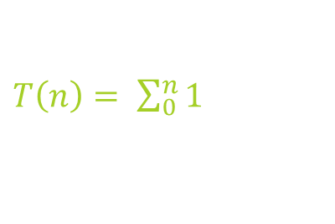
BS Search Analysis {
$T\left(n\right)= \sum_{0}^{n}{1}$
def search(txt, pat):
m = len(pat)
n = len(txt)
badChar = badCharHeuristic(pat, m)
# s is shift of the pattern with respect to text
s = 0
while(s <= n-m):
j = m-1
while j>=0 and pat[j] == txt[s+j]:
j -= 1
if j<0:
s += (m-badChar[ord(txt[s+m])] if s+m<n else 1)
else:
s += max(1, j-badChar[ord(txt[s+j])])
Loops until matching (pat) with (txt)
“at worst case will be n”
Basic Operation
#The condition s+m < n is necessary for the case when pattern occurs at the end of text
}
# Shift the pattern so that the bad character in text
aligns with the last occurrence of it in pattern
Programming Language

Slide 42
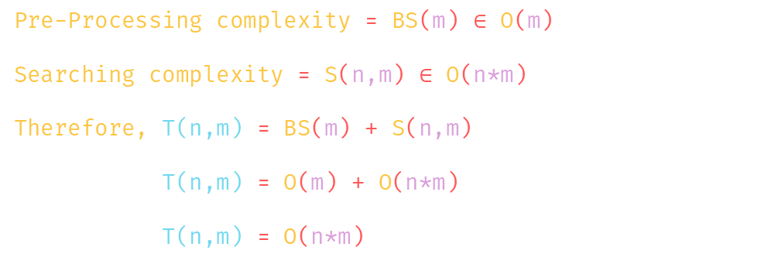
BS-ST Time Complexity {
Pre-Processing complexity = BS(m) $∈$ O(m)
Searching complexity = S(n,m) $∈$ O(n*m)
Therefore, T(n,m) = BS(m) + S(n,m)
T(n,m) = O(m) + O(n*m)
T(n,m) = O(n*m)
}

Slide 43
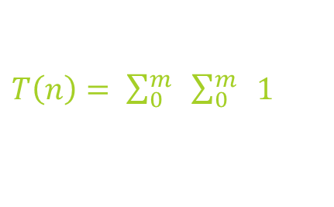
GS-ST Analysis {
$T\left(n\right)= \sum_{0}^{m}{ \sum_{0}^{m}{ 1 }}$
def preprocess_strong_suffix(shift, bpos, pat, len):
i = len
j = len + 1
bpos[i] = j
while i > 0:
# if character at position i-1 is not equivalent to character at j-1, then continue searching to
right of the pattern for border
while j <= len and pat[i - 1] != pat[j - 1]:
# the character preceding the occurrence of t in pattern P is different than the mismatching
character in P, we stop skipping the occurrences and shift the pattern from i to j
if shift[j] == 0:
shift[j] = j - i
# Update the position of next border
j = bpos[j]
# p[i-1] matched with p[j-1], border is found. Store the beginning position of border
i -= 1
j -= 1
bpos[i] = j
Loops on Text
Loops on matching part
Basic Operation
}
Programming Language

Slide 44

GS-ST Analysis {
def preprocess_case2(shift, bpos, pat, m):
j = bpos[0]
for i in range(m + 1):
''' set the border position of the first character
of the pattern to all indices in array shift
having shift[i] = 0 '‘’
if shift[i] == 0:
shift[i] = j
''' suffix becomes shorter than bpos[0],
use the position of next widest border
as value of j '‘’
if i == j:
j = bpos[j]
# Preprocessing for Good Suffix Case 2
$$\sum_{0}^{m}{1}=O(m)$$
}
Programming Language

Slide 45

GS Search Analysis {
$T\left(n\right)= \sum_{0}^{n}{ \sum_{0}^{m}{ 1 }}$
def search(text, pat):
s = 0
m = len(pat)
n = len(text)
# initialize all occurrence of shift and border pos to 0
bpos = [0] * (m + 1)
shift = [0] * (m + 1)
preprocess_strong_suffix(shift, bpos, pat, m)
preprocess_case2(shift, bpos, pat, m)
while s <= n - m:
#Keep reducing index j of pattern while characters of pattern and text are matching at this shift s
j = m – 1
while j >= 0 and pat[j] == text[s + j]:
#If the pattern is present at the current shift, then index j will become -1 after the above loop
j -= 1
if j < 0:
s += shift[0]
else:
s += shift[j + 1]
Loops on Text max = (n)
Loops on matching part of pattern max = (m)
}
pat[i] != pat[s+j] so shift the pattern shift[j+1] times

Slide 46
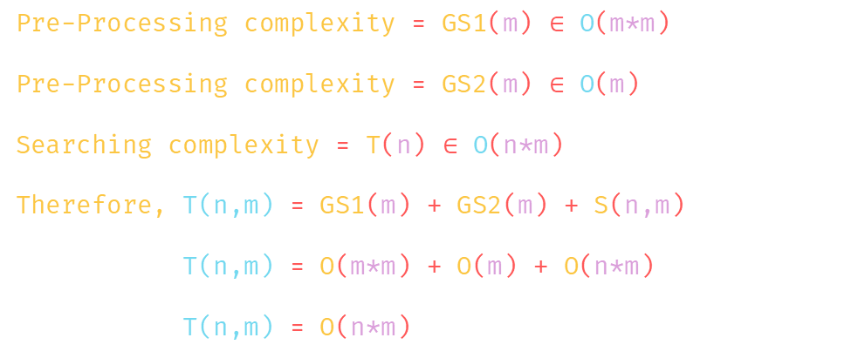
GS-ST Time Complexity {
Pre-Processing complexity = GS1(m) $∈$ O(m*m)
Pre-Processing complexity = GS2(m) $∈$ O(m)
Searching complexity = T(n) $∈$ O(n*m)
Therefore, T(n,m) = GS1(m) + GS2(m) + S(n,m)
T(n,m) = O(m*m) + O(m) + O(n*m)
T(n,m) = O(n*m)
}

Slide 47

Boyer Moore’s Algorithm {
It uses information gathered during the preprocess step to skip sections of the text, resulting in a lower constant factor than many other string search algorithms. In general, the algorithm runs faster as the pattern length increases.
}

